Slide 1
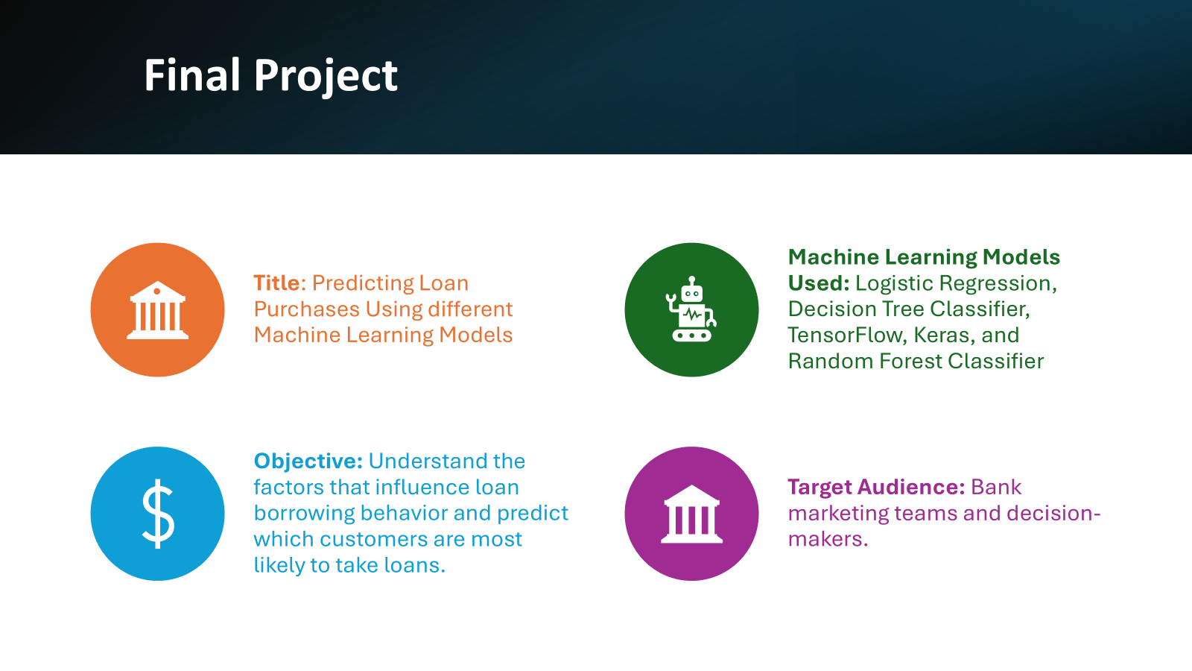

Slide 2



Project Overview
Context: Thera Bank aims to convert liability customers into personal loan customers while retaining them as depositors.
Background: Last year's campaign for liability customers had a successful conversion rate of 9%.
Goal: The retail marketing department seeks to enhance targeting strategies and improve conversion success through more effective campaigns.

Slide 3

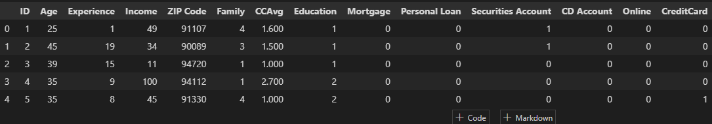
Data Set/Considerations/Variables
Objective:
The classification goal is to predict the likelihood of a liability customer buying personal loans
Data Source :
https://www.kaggle.com/datasets/krantiswalke/bank-personal-loan-modelling
Data Set/ Considerations/ Variables
ID: Customer ID
Age: Customer’s age in completed years
Experience: #years of professional experience
Income: Annual income of the customer (in thousand dollars)
ZIP Code: Home Address ZIP code.
Family: the Family size of the customer
CCAvg: Average spending on credit cards per month (in thousand dollars)
Education: Education Level. 1: Undergrad; 2: Graduate;3: Advanced/Professional
Mortgage: Value of house mortgage if any. (in thousand dollars)
Personal_Loan: Did this customer accept the personal loan offered in the last campaign?
Securities_Account: Does the customer have securities account with the bank?
CD_Account: Does the customer have a certificate of deposit (CD) account with the bank?
Online: Do customers use internet banking facilities?
Credit Card: Does the customer use a credit card issued by any other Bank (excluding All life Bank)?

Slide 4

Preprocessing:
Handle missing values (if any).
Scale numerical features (like Income and Age) for logistic regression.
Model Selection:
Decision Tree: Non-linear model to identify key splits and decision rules.
Logistic Regression: Linear model for estimating probability of loan purchase.
Target Variable: Personal Loan (1 = Yes, 0 = No).
Optimize Data Types: Convert “Personal_Loan,’’ “Securities_Account”,”CD_Account”,” Online’’ ,” CreditCard”, and “Education” from int/object to category type to reduce data space.
Dropped "Experience" due to strong correlation with “Age”.
Mapped 450 unique zip codes to counties and regions, reducing data dimensions to 5 values.
Created Age bins, Spending groups, and Income groups to identify patterns in loan purchases.

Slide 5


Slide 6
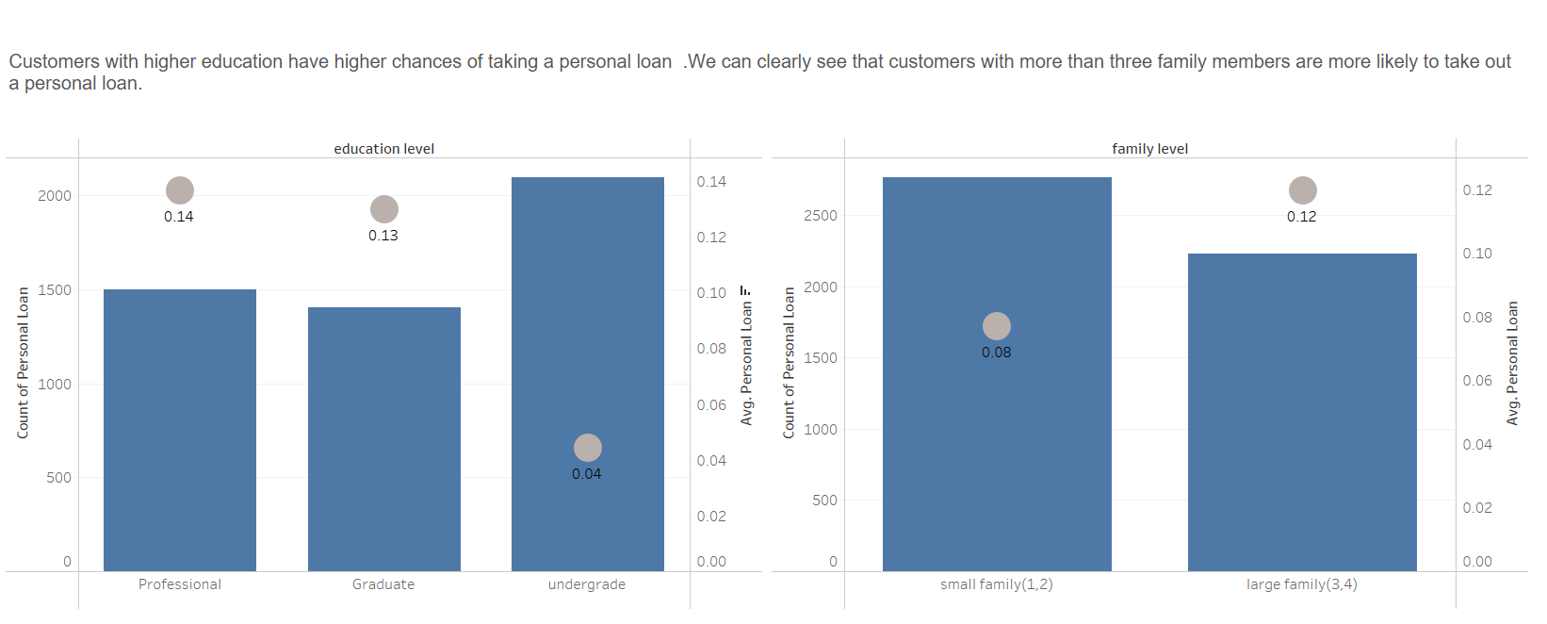

Slide 7
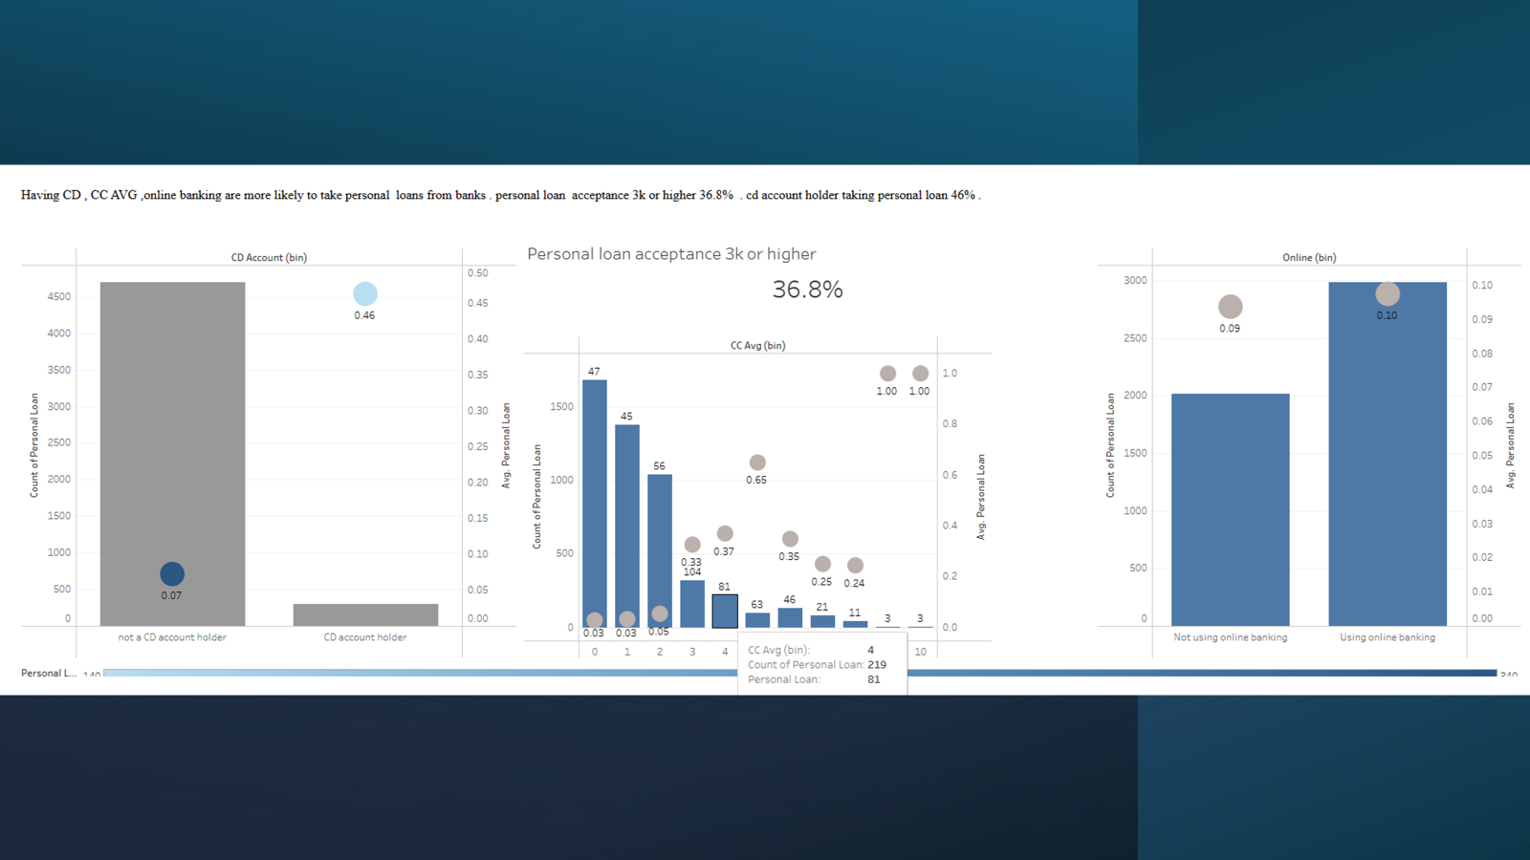

Slide 8
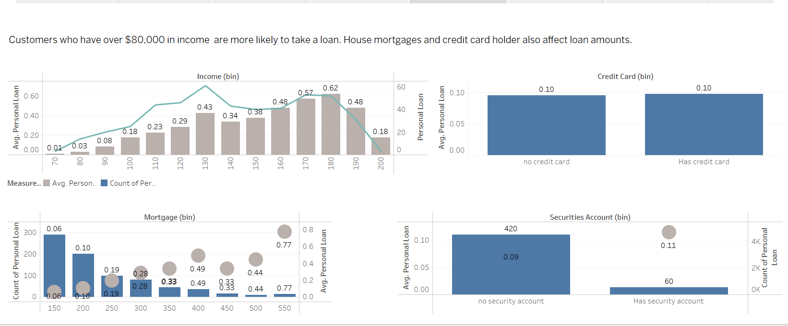

Slide 9
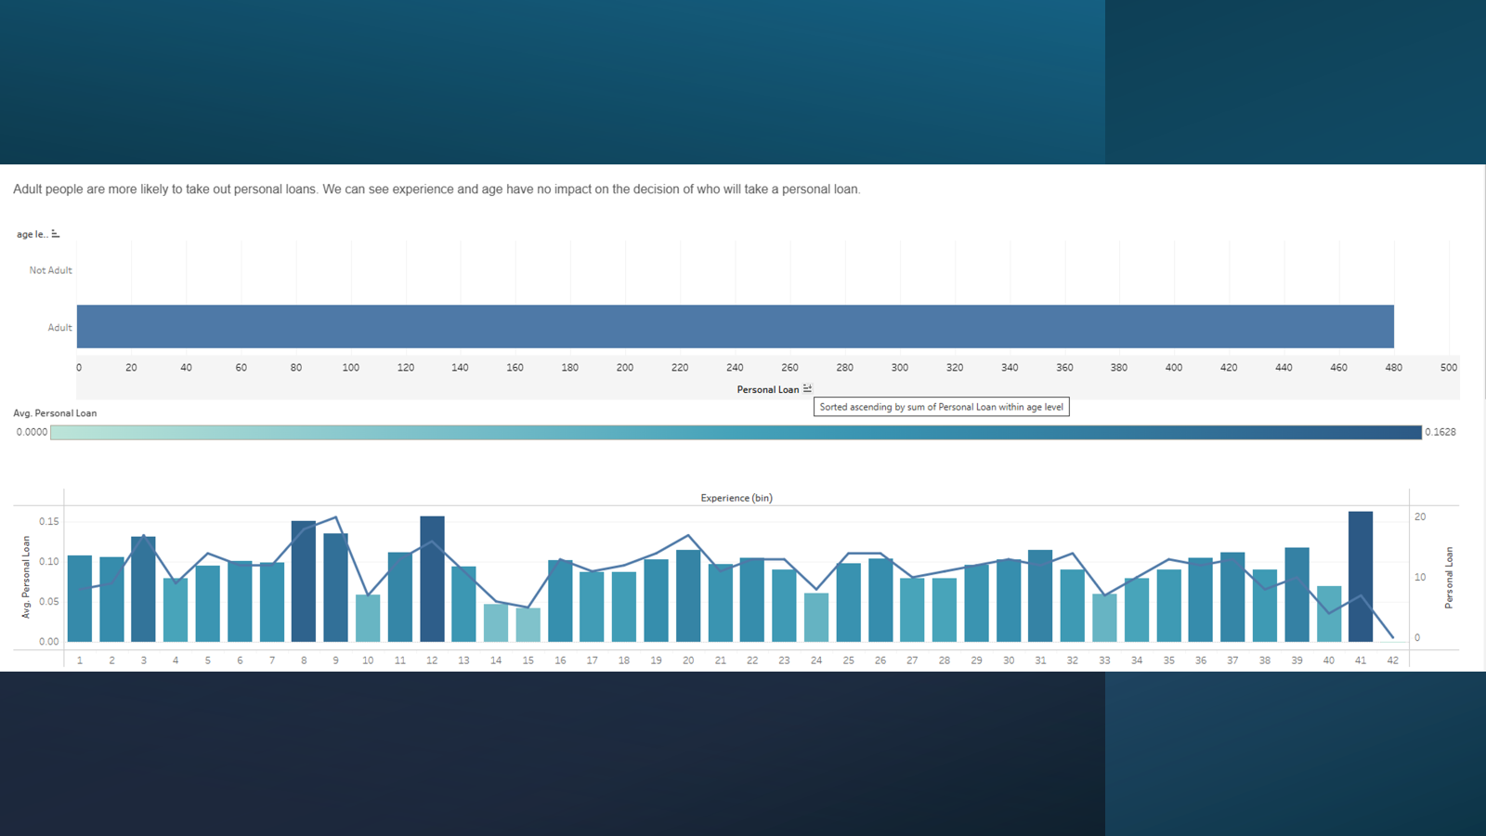

Slide 10
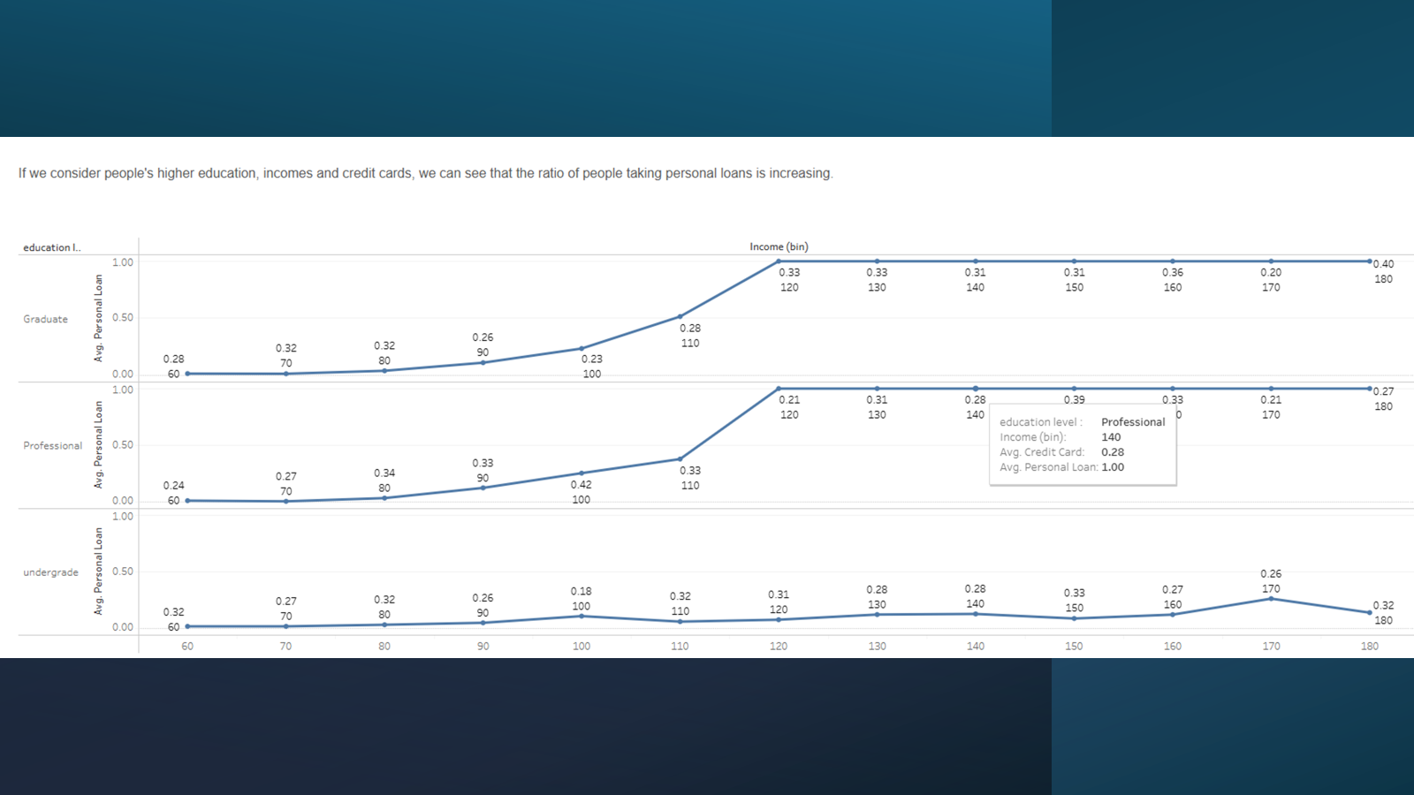

Slide 11
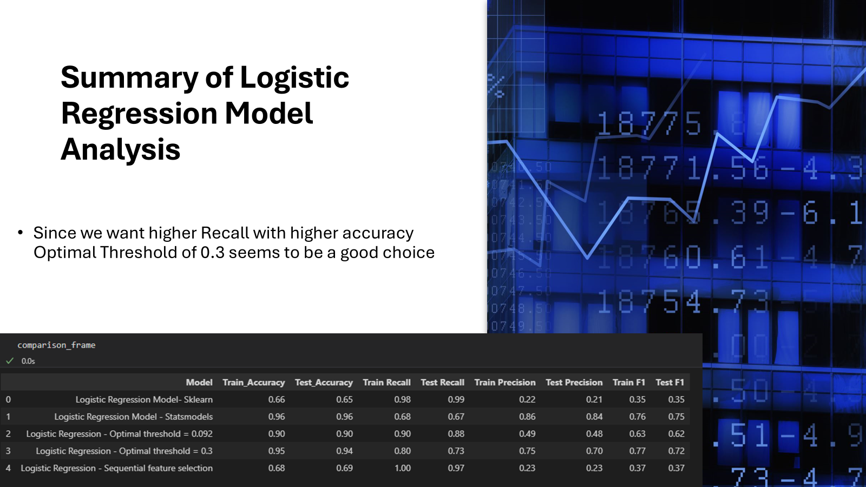

Slide 12
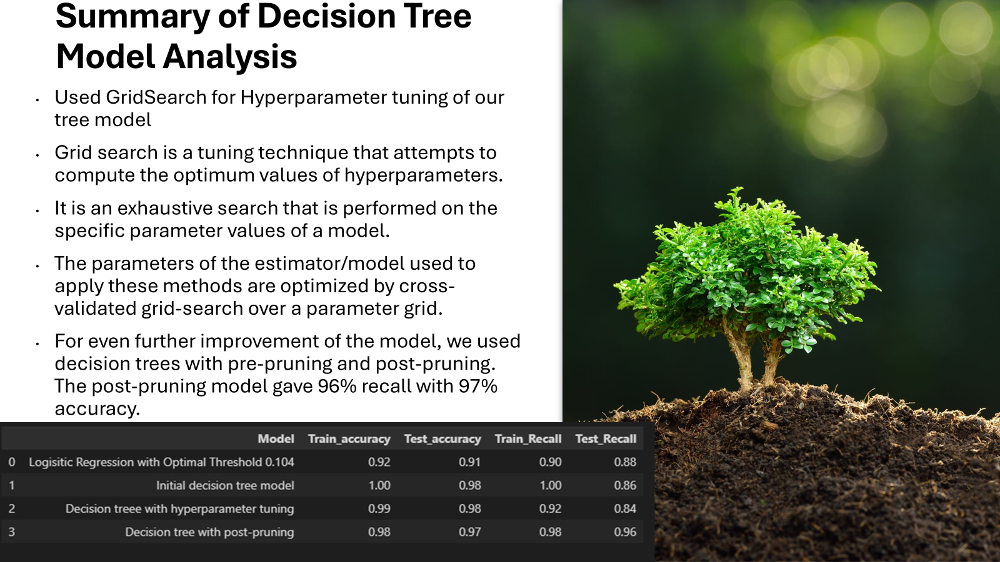

Slide 13
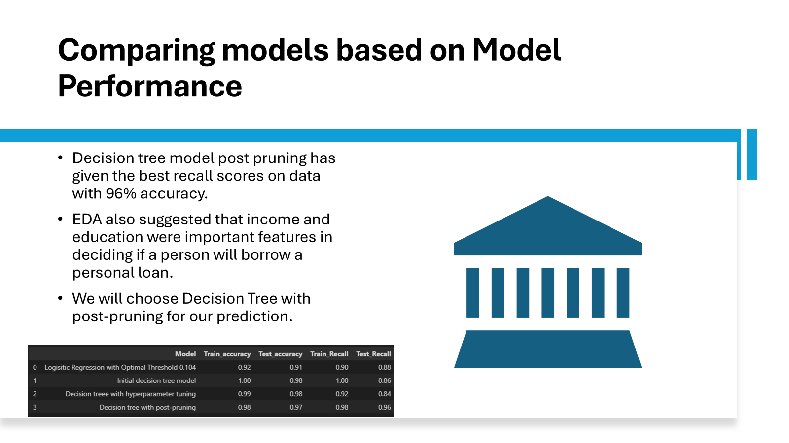

Slide 14
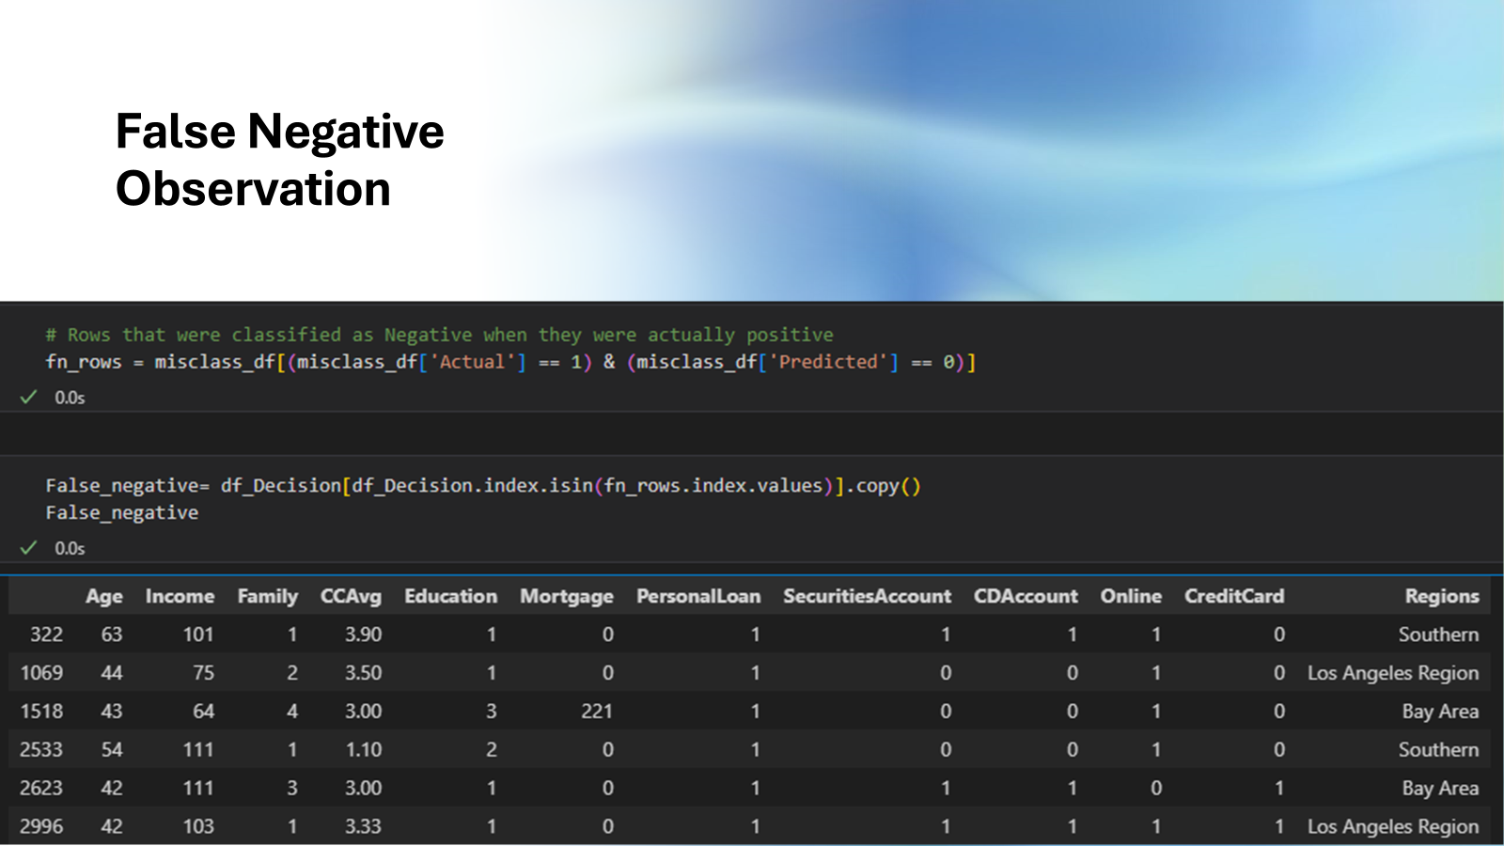

Slide 15
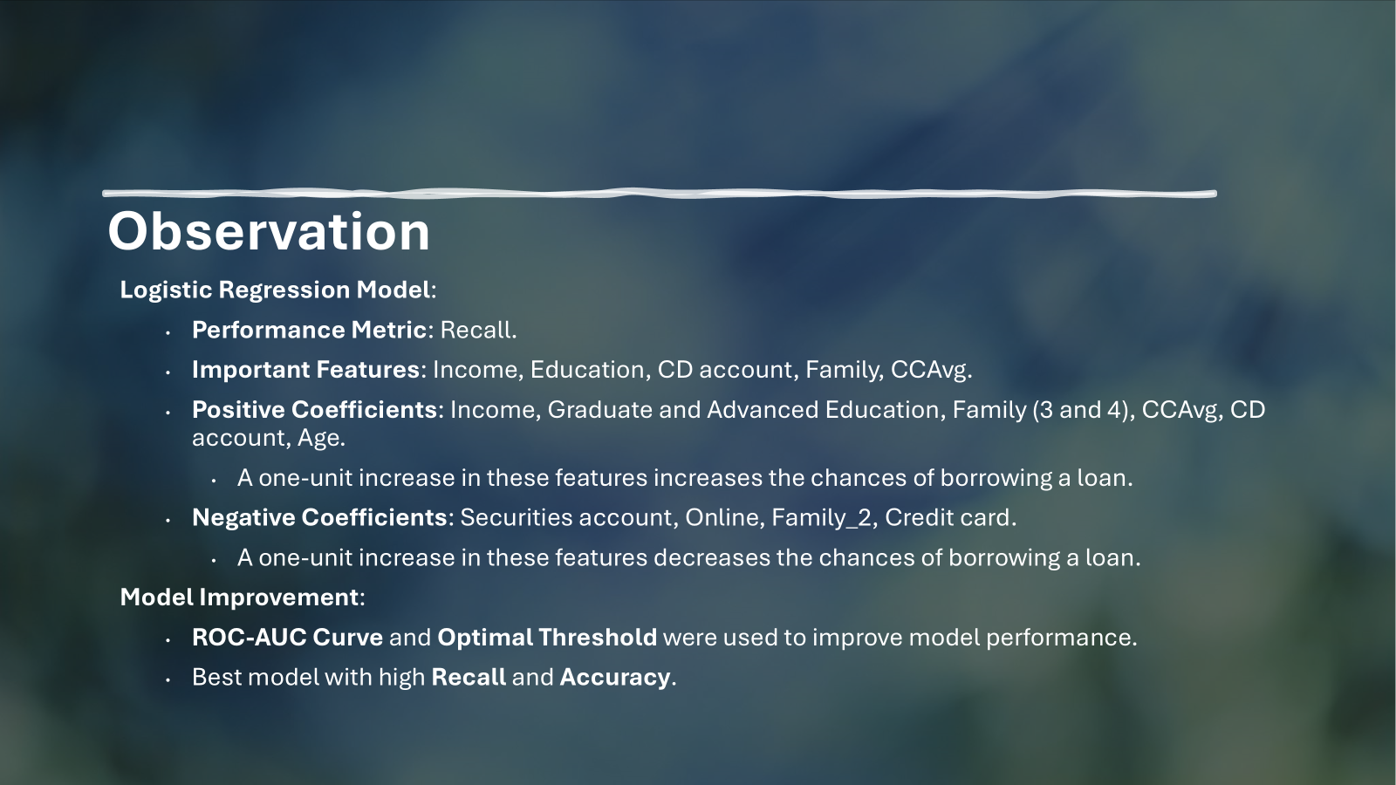

Slide 16
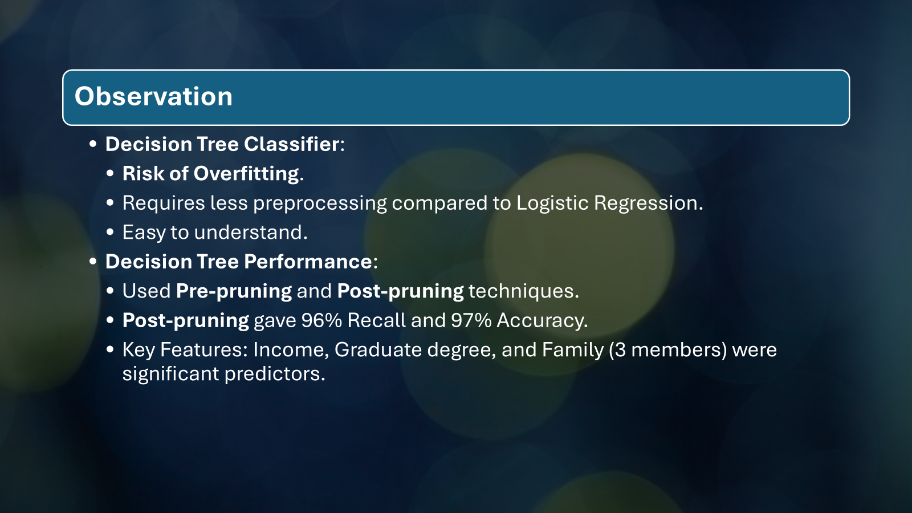

Slide 17
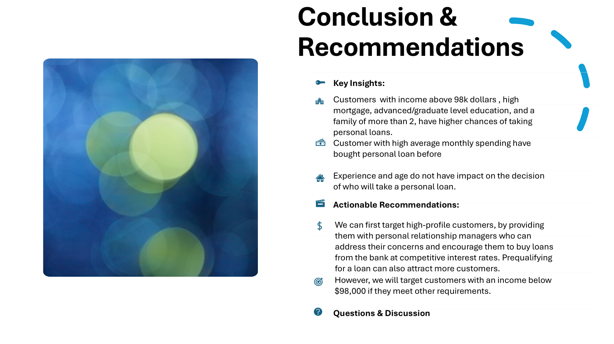

Slide 18
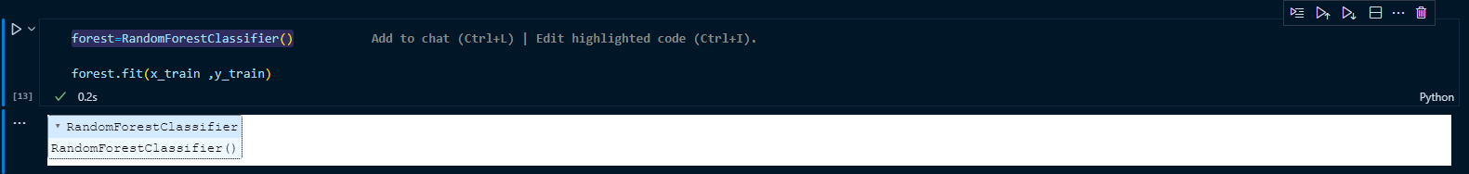
Machine Learning model
The following data is used
Random Forest Classifier
Training and Testing in Model Evaluation
The Percentage of Random Forest Model Train is
98.7333

Slide 19
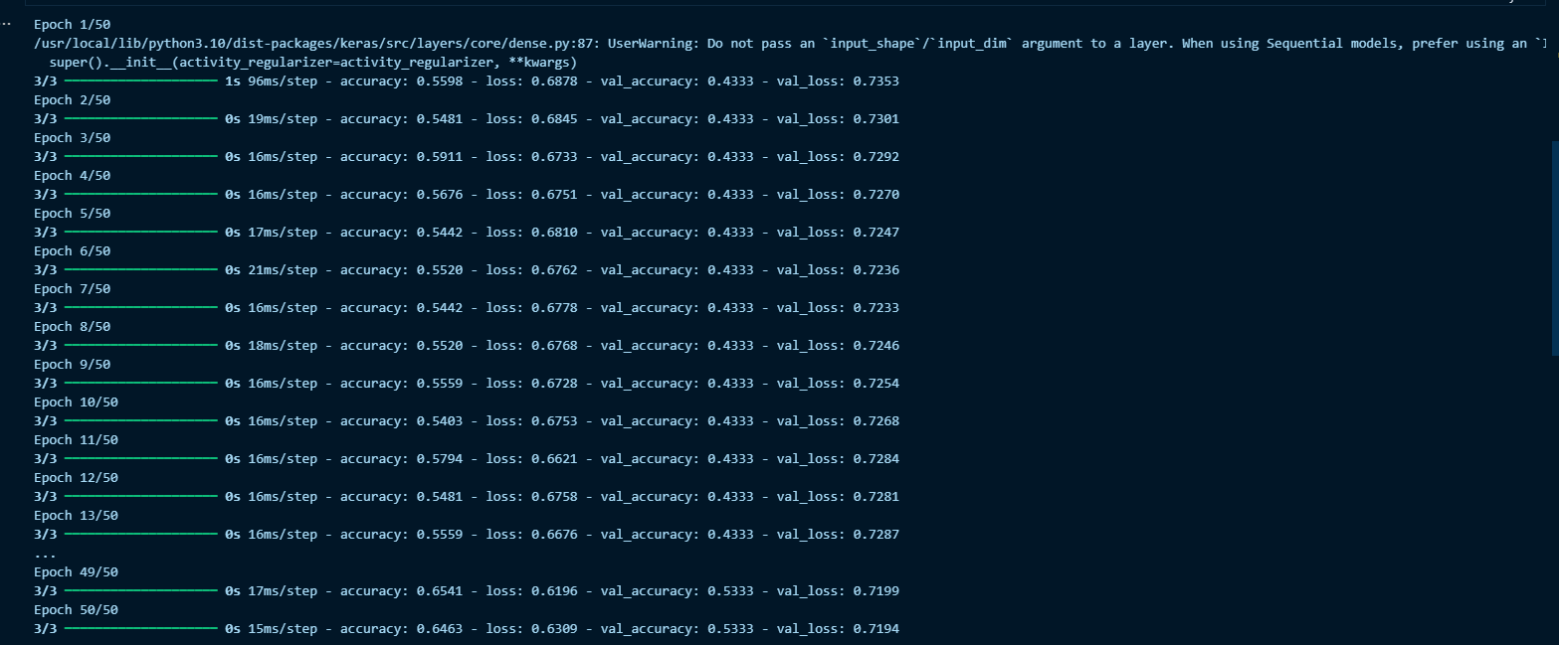
Training and Testing in Model Evaluation

Slide 20
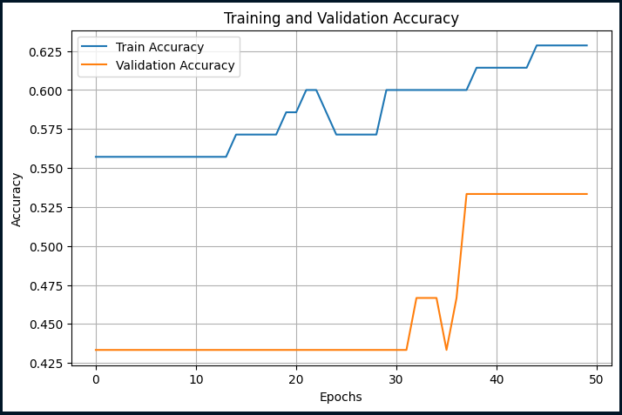
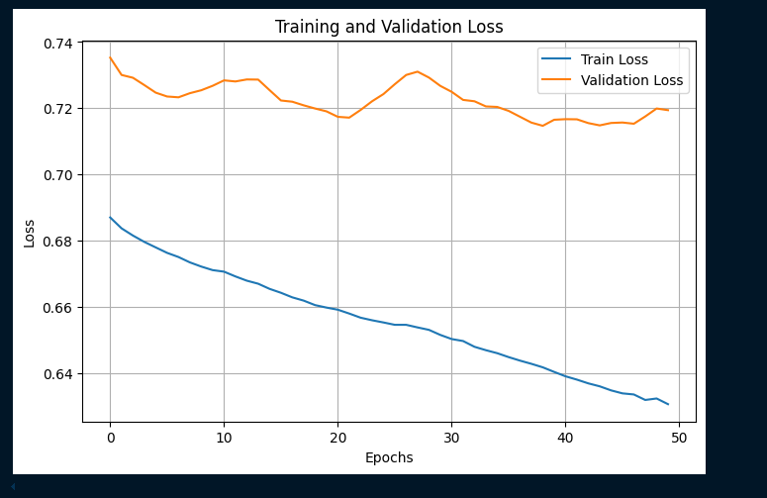

Slide 21
Zip code addition
Add zip code in the code to get the geographical location of the data
use Pgeocode library

Slide 22
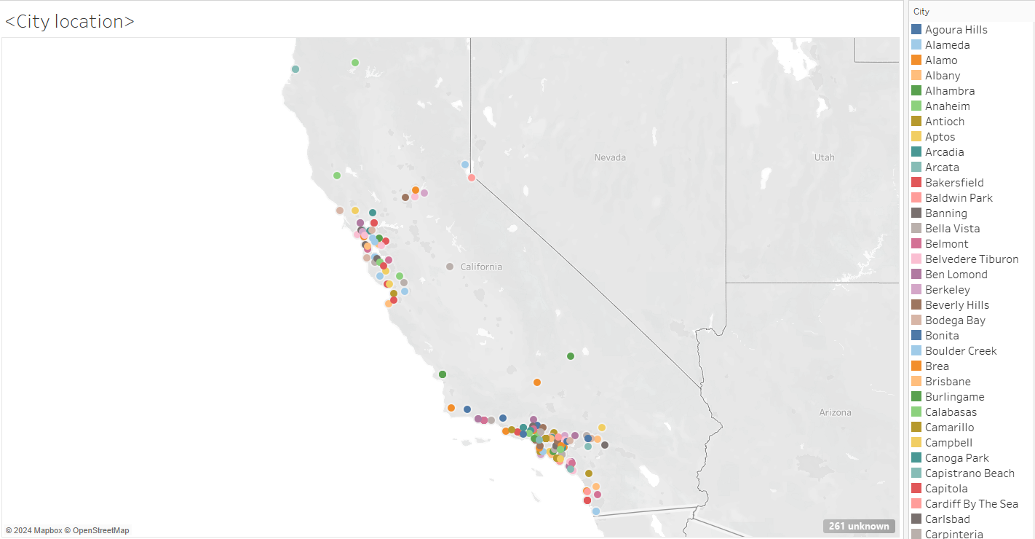
Geographical location of the cites

Slide 23
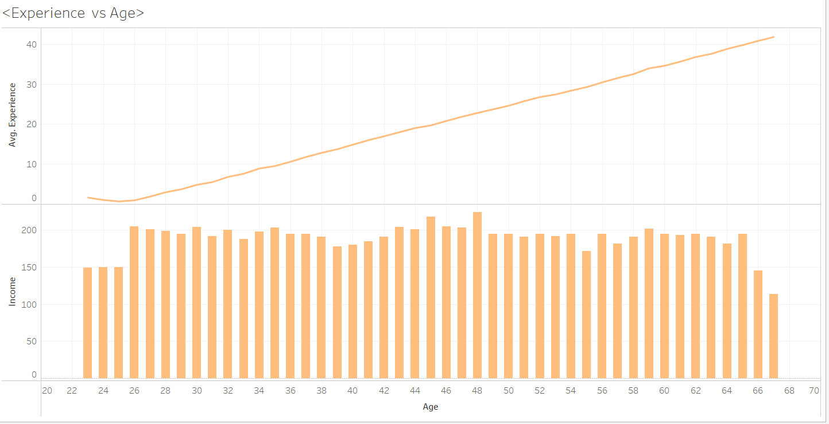
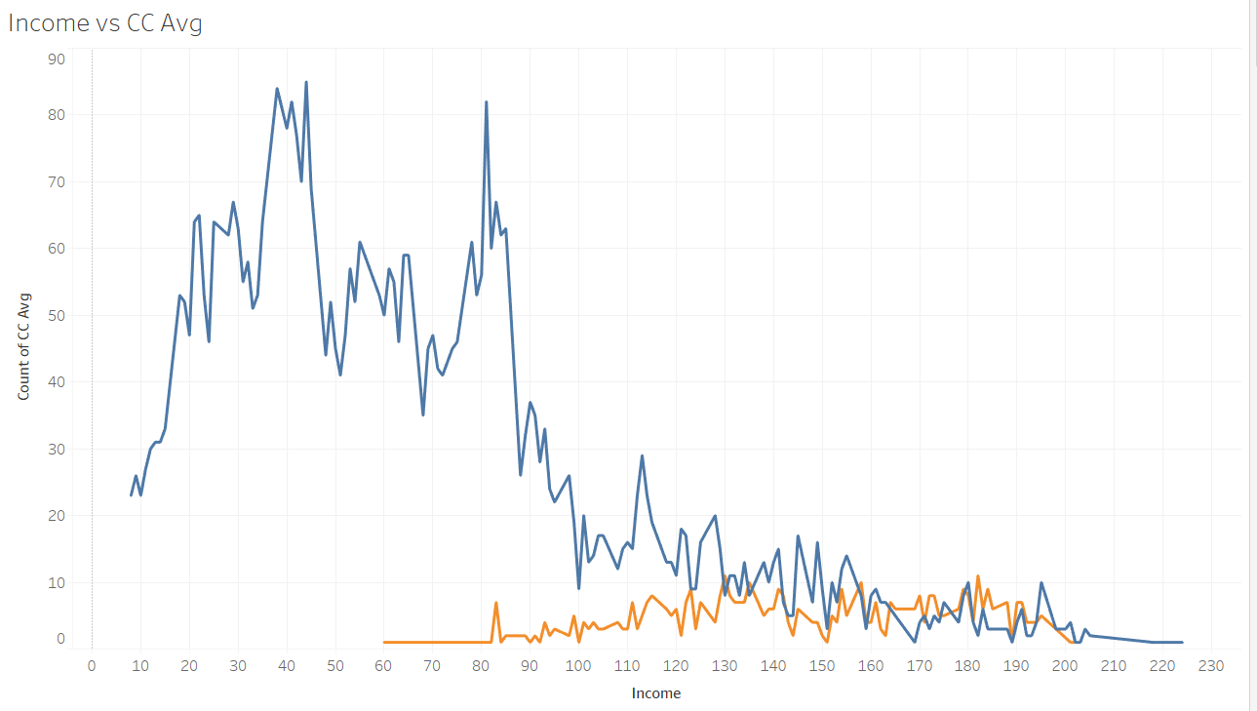
Age, Income and Credit card comparison

Slide 24
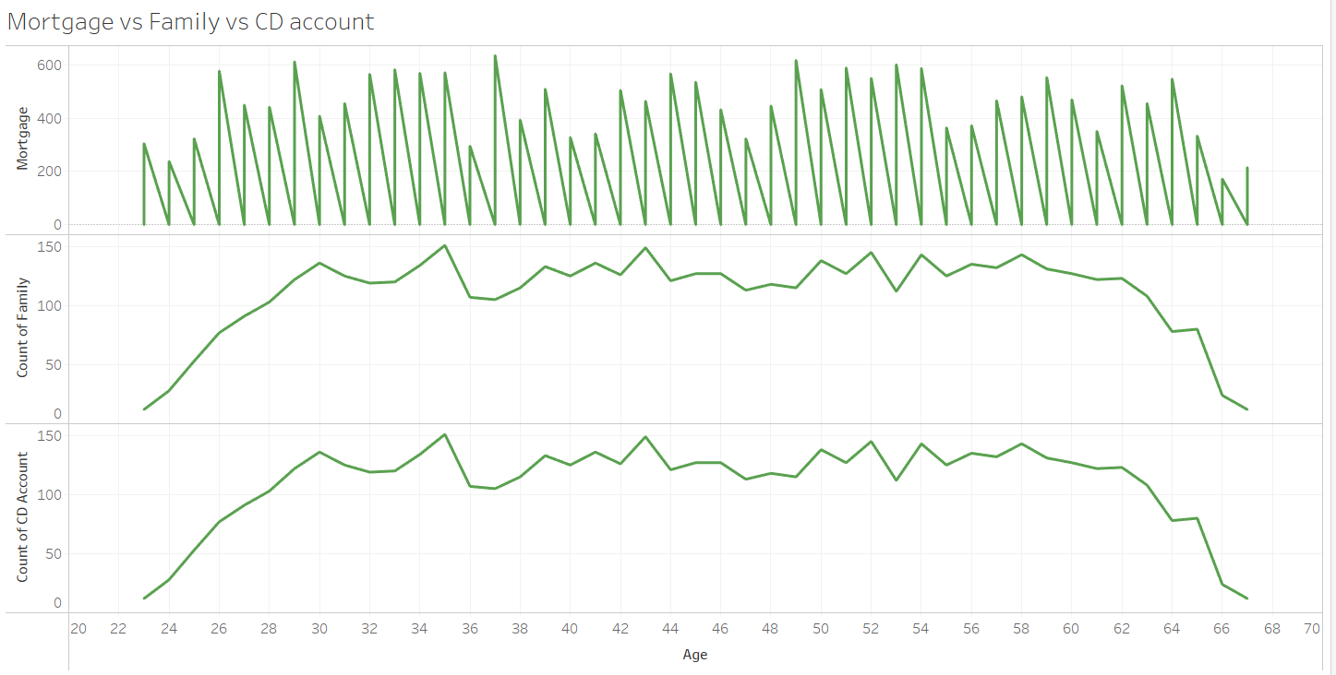
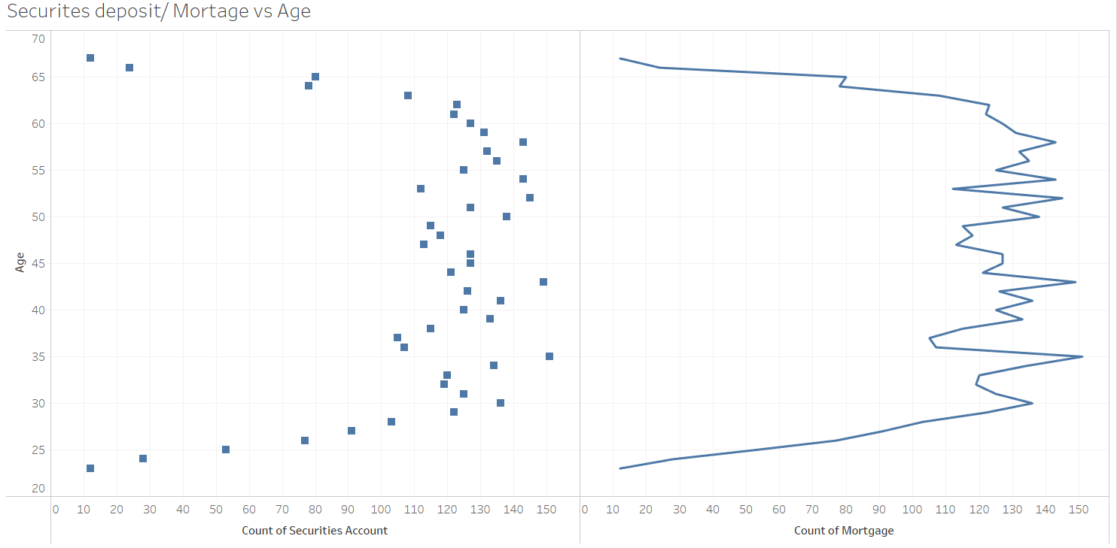
Securities deposit,Mortgage, Family Comparison

Slide 25
Conclusion
Next Target Customers would be :
Criteria :
Customer with 6 digit figure, High mortgages and family more than 2.
having high chances of taking personal loans.
more
Location:
The huge gap between the Marina(zip code 93933) and San luis obispo (zip code 93401)california city.

Slide 26
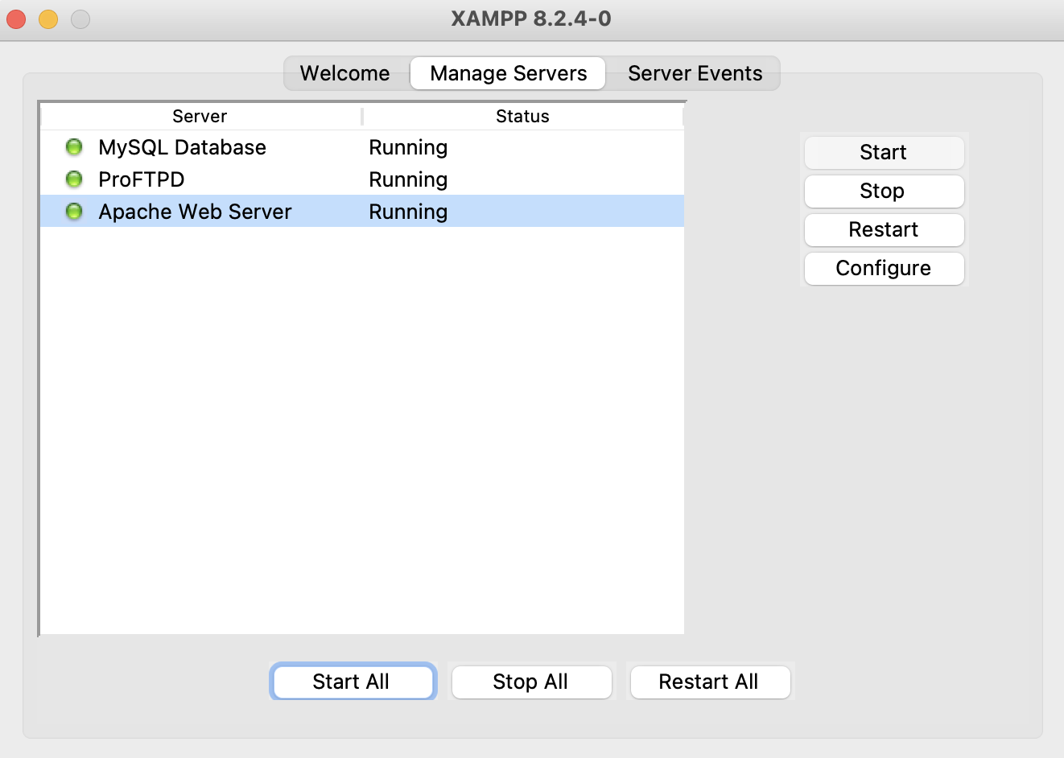
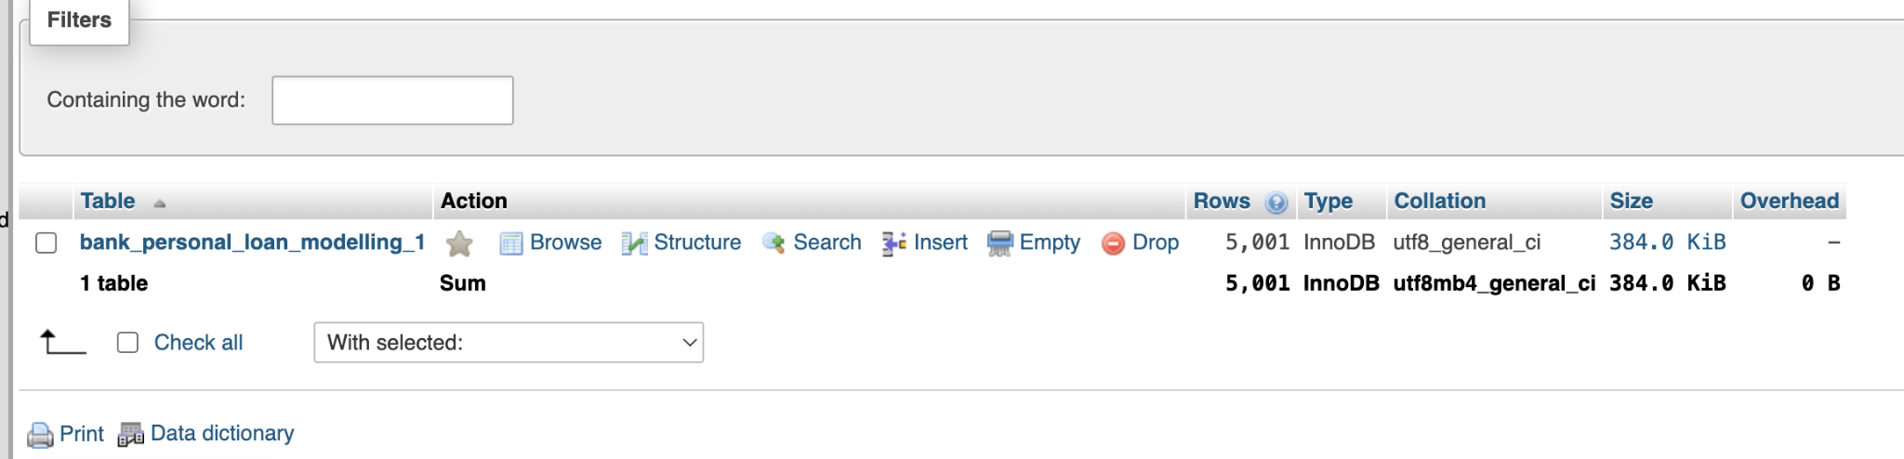
SQL Data EDA:
MariaDB is an open-source relational database management system (RDBMS) that is a community-developed fork of MySQL
Notes:
I'm using MariaDB to analyze our data because, for some reason, I couldn't access PostgreSQL. MariaDB is hosted on the XAMPP platform, which is also an open-source environment. In the lower part of the slide displayed on the MariaDB website, you can see that our dataset contains over 5,000 rows.

Slide 27
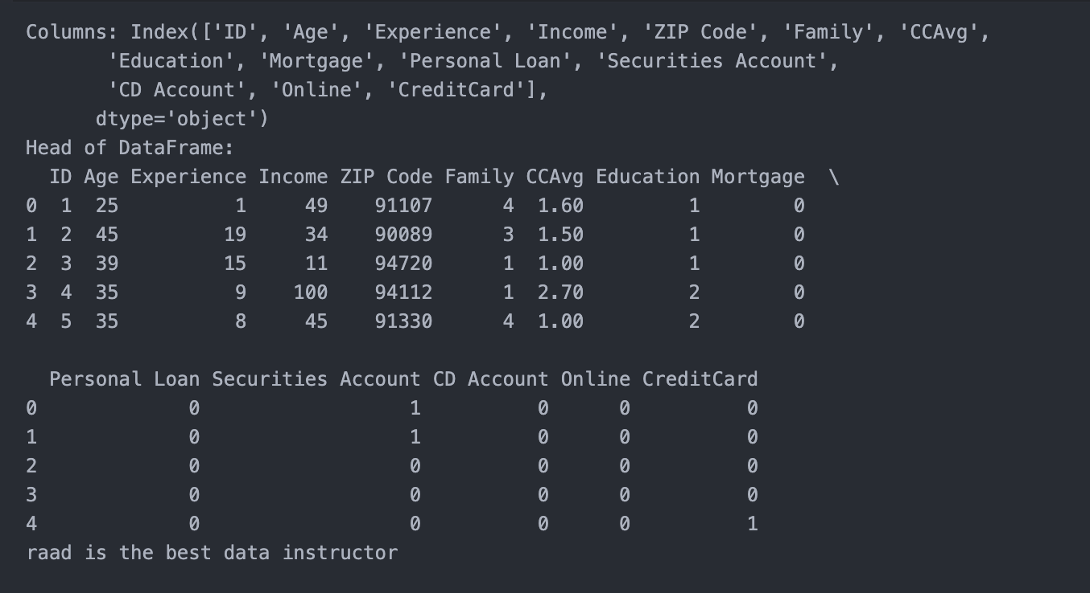
SQL Data EDA:
Notes:
I imported and cleaned the data in Visual Studio Code using Python, ensuring there are no null entries. The dataset includes numerous variables; we will use "loan" as the dependent variable, with the remaining columns serving as predictors.

Slide 28
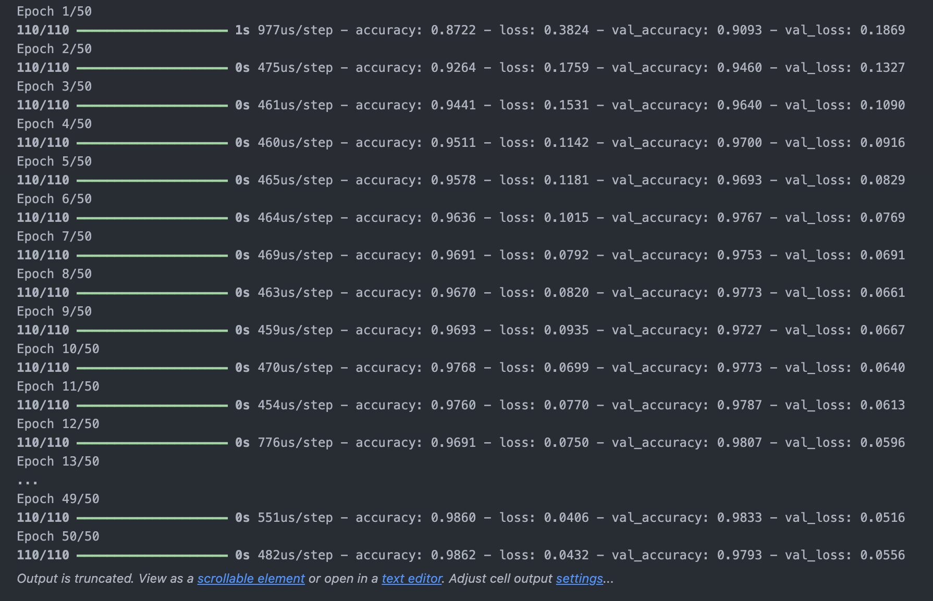
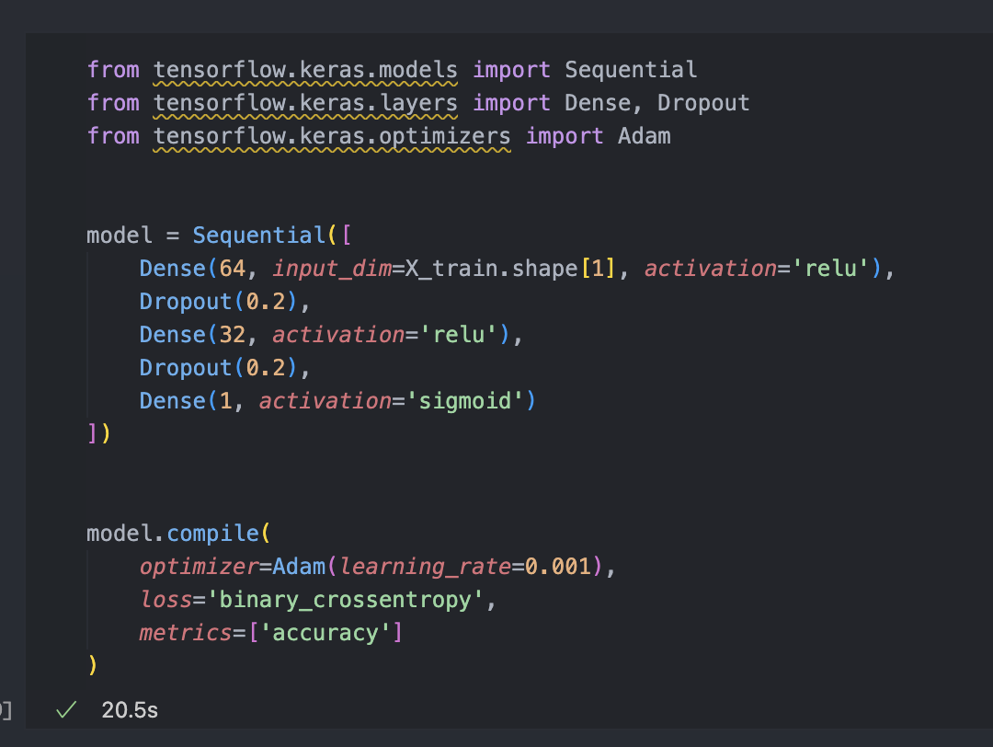
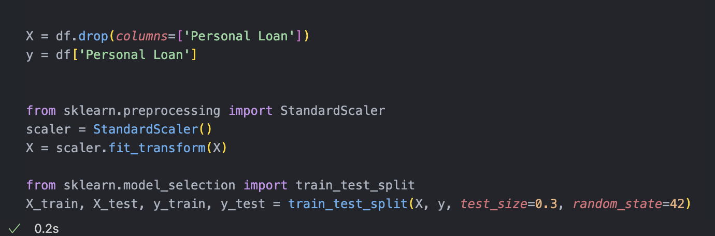
Machine learning
Model Prediction
Notes:
I partitioned the data into training and testing sets using scikit-learn's data selection tools. I then built our model using Keras from TensorFlow, employing the "Adam" optimizer. The results were quite promising, achieving nearly 99% accuracy.

Slide 29
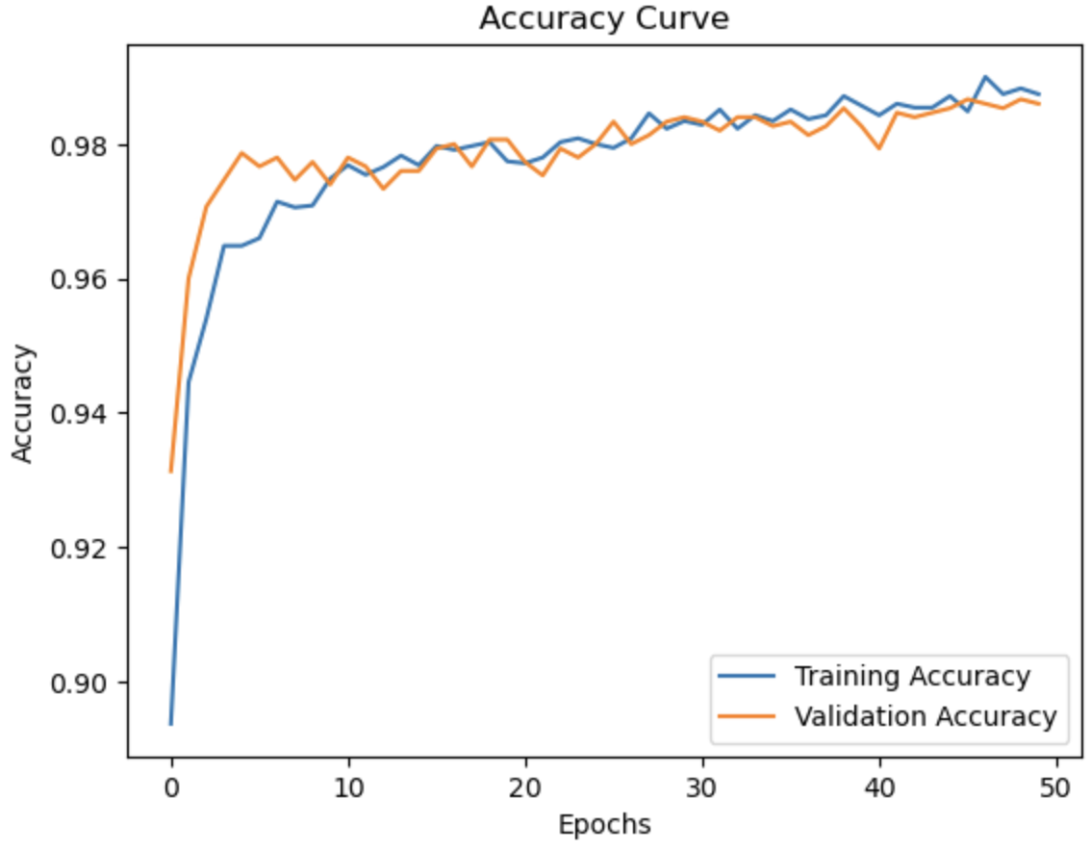
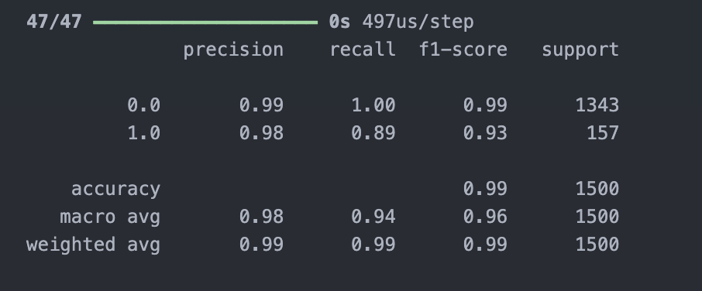
Accuracy Curve
Notes:
This slide presents the performance metrics of our machine learning model, showcasing the Accuracy Curve alongside precision, recall, F1-score, and support details. The Accuracy Curve graphically illustrates the model's training and validation accuracy across 50 epochs, indicating robust learning over time. The table provides a detailed breakdown of classification metrics, highlighting excellent precision and recall rates for our classes, contributing to an overall accuracy of 99%. This demonstrates the model's effectiveness in making reliable predictions.

Slide 30
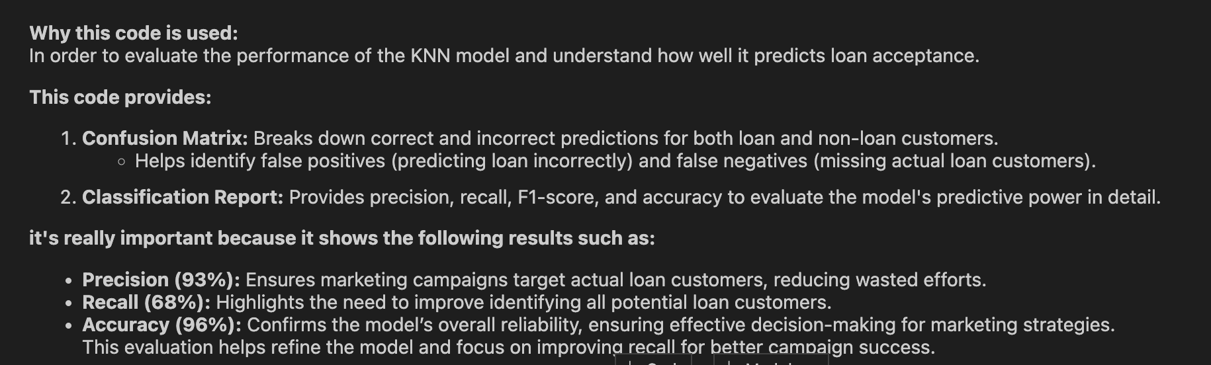
Loan Acceptance Prediction Model

Slide 31
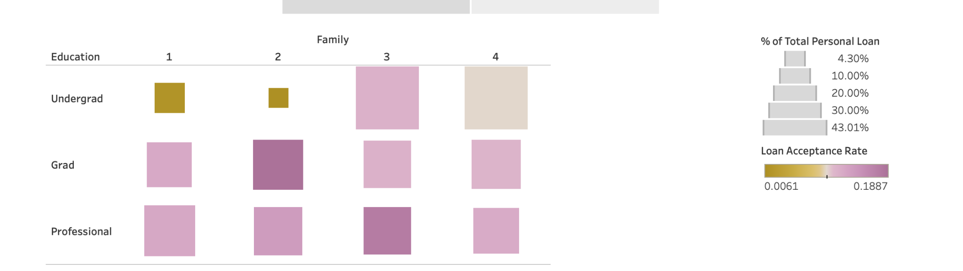
Loan Acceptance by Family Size and Education Level
Tableau Story

Slide 32
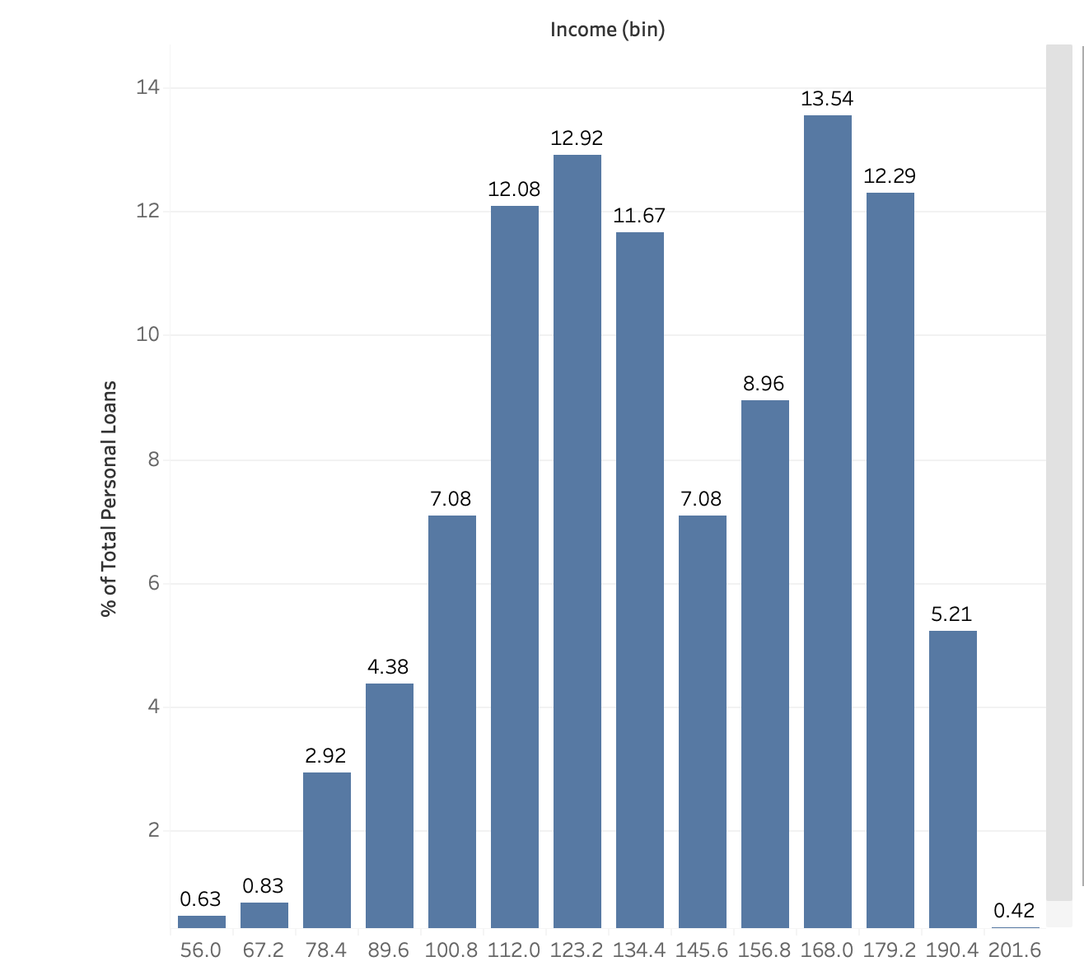
Percent of Total Loan by Income Bracket

Slide 33

Thank you

